Slide 1
RAD (RAPID APPLICATION DEVELOPMENT) MODEL

Slide 2
DEFINITION:
RAD (Rapid Application Development) is a concept that products can be developed faster and of higher quality through:
Gathering requirements using workshops or focus groups
Prototyping and early, reiterative user testing of designs
The re-use of software components
A rigidly paced schedule that refers design improvements to the next product version
Less formality in reviews and other team communication

Slide 3
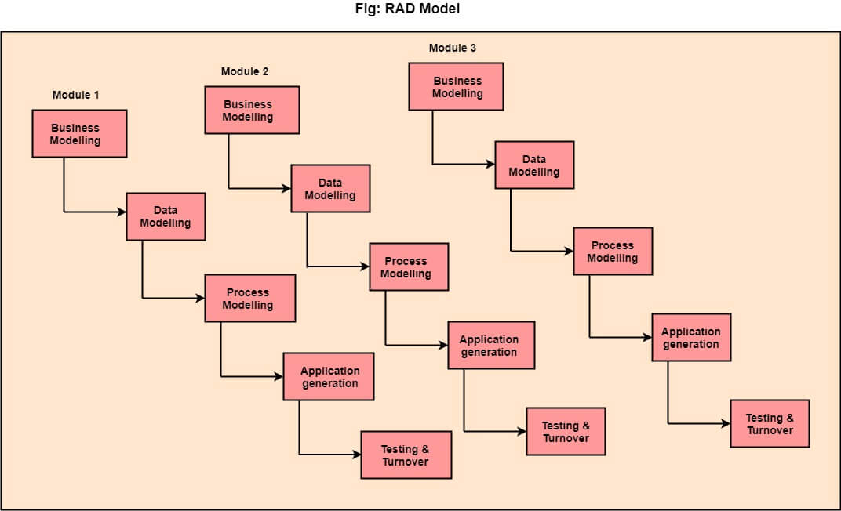

Slide 4
PHASES:
1.Business Modelling
2. Data Modelling
3. Process Modelling
4. Application Generation
5. Testing & Turnover

Slide 5
When to use RAD Model?
When the system should need to create the project that modularizes in a short span time (2-3 months).
When the requirements are well-known.
When the technical risk is limited.
When there's a necessity to make a system, which modularized in 2-3 months of period.
It should be used only if the budget allows the use of automatic code generating tools.

Slide 6
ADVANTAGE:
This model is flexible for change.
In this model, changes are adoptable.
Each phase in RAD brings highest priority functionality to the customer.
It reduced development time.
It increases the reusability of features.

Slide 7
DISADVANTAGE:
It required highly skilled designers.
All application is not compatible with RAD.
For smaller projects, we cannot use the RAD model.
On the high technical risk, it's not suitable.
Required user involvement.

Slide 8
THANK YOU

